Slide 1

Presentation Topic : Writing CV & Cover Letter
Subject: PLSD
Section: A
Subject Code: PSD 400
PRESENTED BY
SHUVOBROTO BISWAS
ID: 183002066
Md.Shakil Ahmed
ID: 191002244
Department of CSE
PRESENTED TO
Department of CCD
Green University of Bangladesh

Slide 2
Contents
CV
What is a CV?
When should you use a CV?
How long should a CV be?
What information should a CV include?
Cover Letter
What is Cover letter?
When Should you use a Cover letter?
How long should be a Cover letter
What information should a Cover letter include?

Slide 3

What is cv?
CV is a represention of your professional life or exprencies.
It could be represent you in
a job board or sortlisted

Slide 4
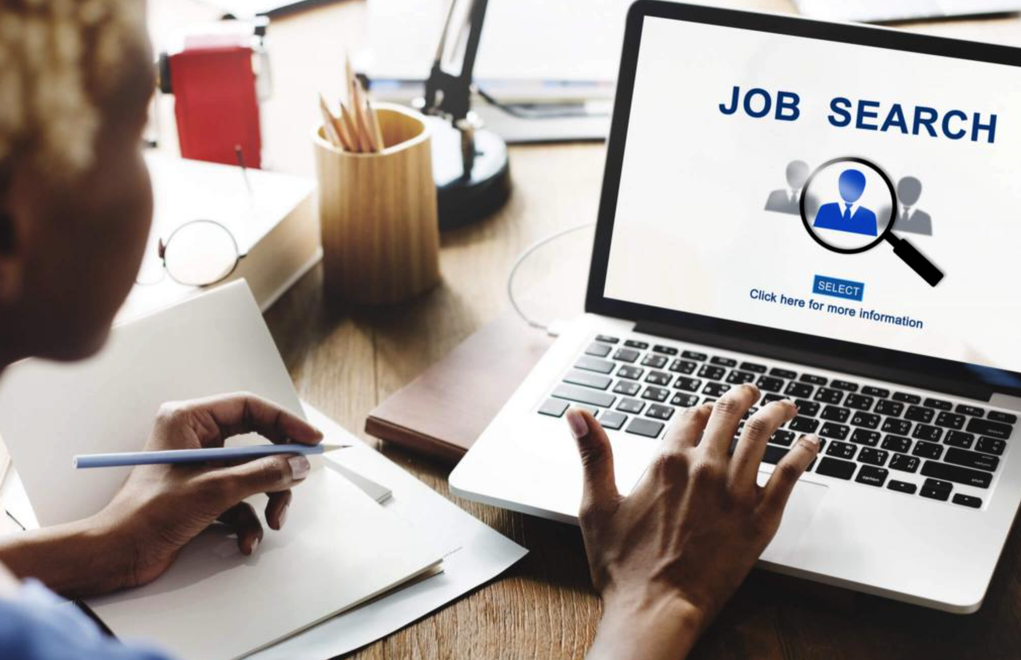
When should you use a CV?
You should use your CV at applying a new job

Slide 5
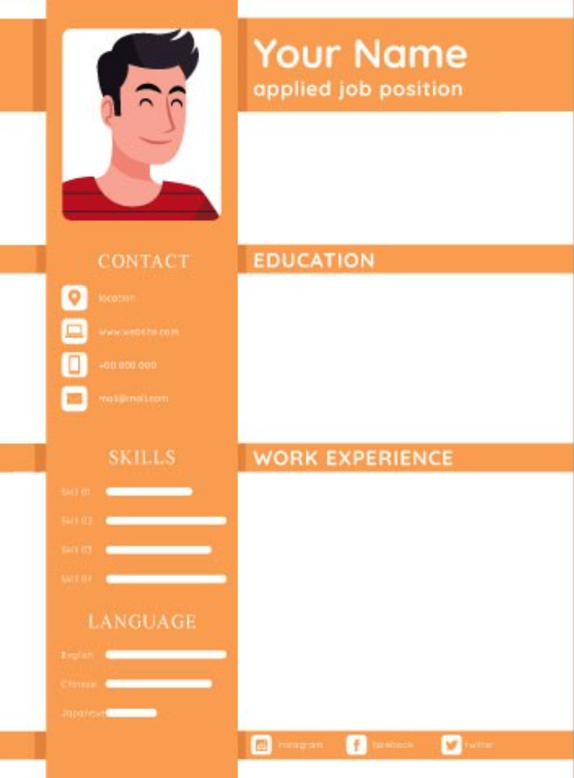
How long should a CV be?
It must be in a single page as Updated Tech CV

Slide 6

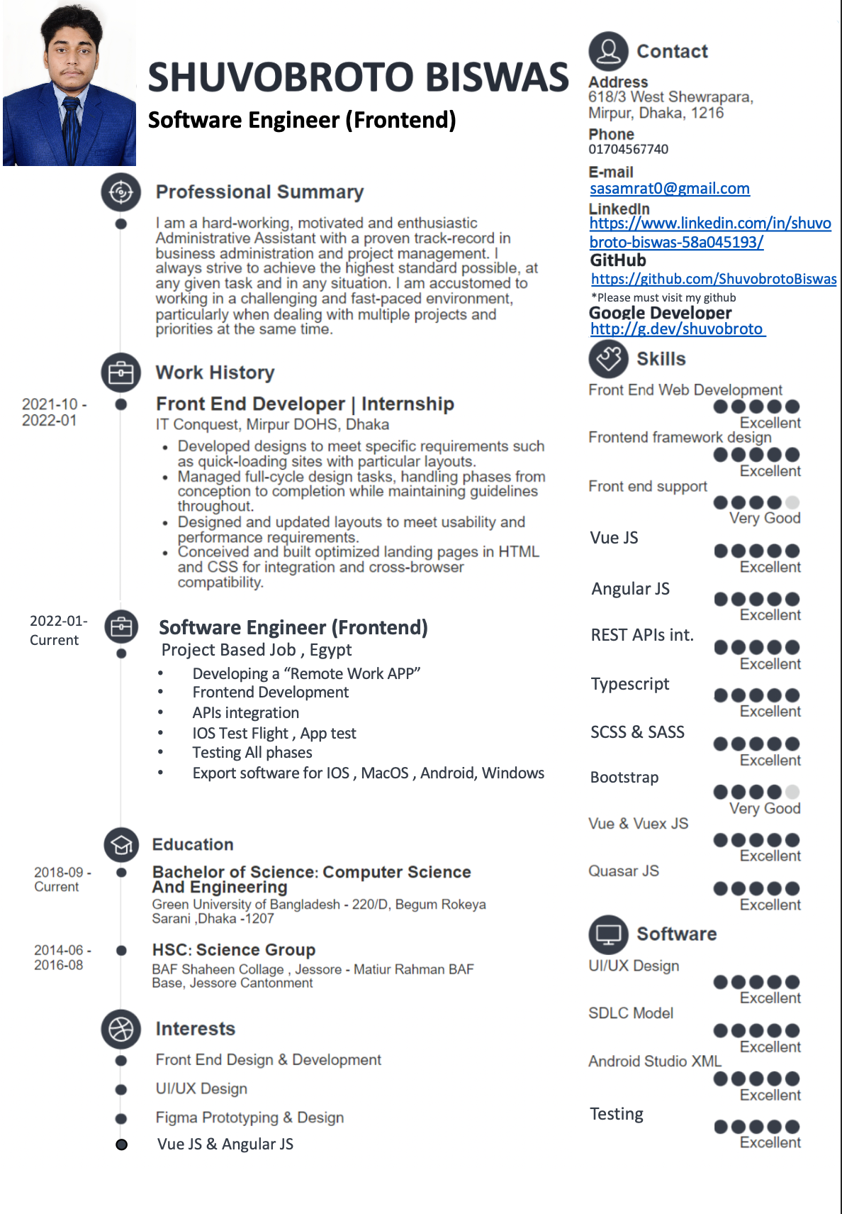
What information should a CV include?
Mr Jhon
********
*****

Slide 7
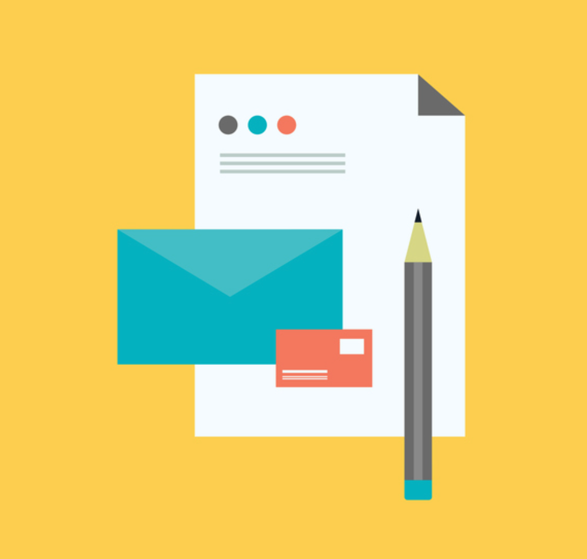
Cover Letter
What is Cover letter?
Cover letter means your application
describtions on your desier job , it is a one-page
document that you should submit as part of your
job application among with CV

Slide 8
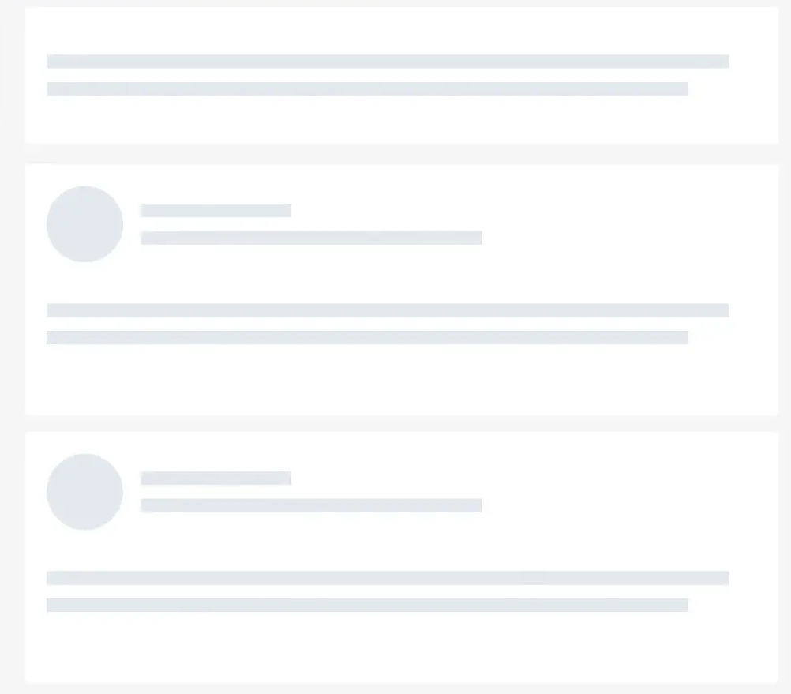
When Should you use a Cover letter?
We need to use cover letter among
with CV in a job application

Slide 9
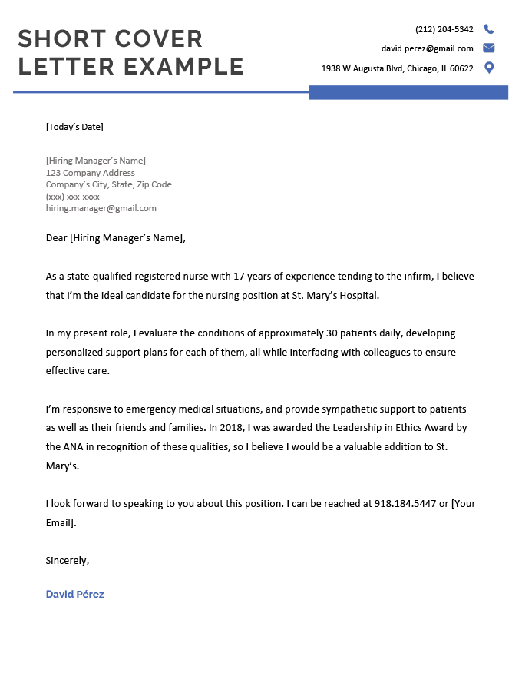
Name
When Should you write a Cover letter?

Slide 10
Thank you everyone

